Slide 1
Dot digital Website proposal

Slide 2
Abstract
The drivers for electronic commerce are both technological (under the tremendous pressure of innovation) and business oriented. This paper will highlight some guidelines for companies who are entering into E-commerce to create an E-commerce strategy or who already have an E-commerce presence to revise their existing strategy.
E-Commerce is now seen as a reality for many businesses and a normal part of a business plan. The immediate benefits, in terms of cost savings, efficiencies and enhanced profitability are clear at every stage in the supply chain.
Adopting e-business is no longer a competitive advantage, but a normal business process, without which an enterprise is unlikely to survive in the New economy.

Slide 3
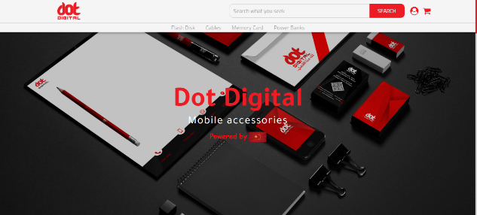
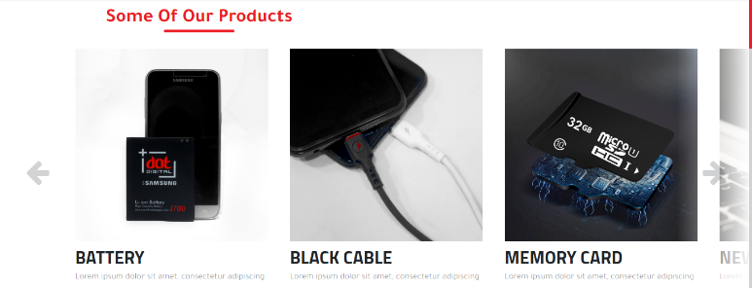
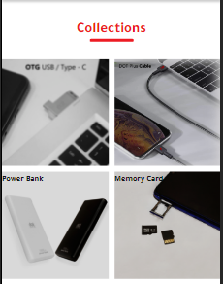
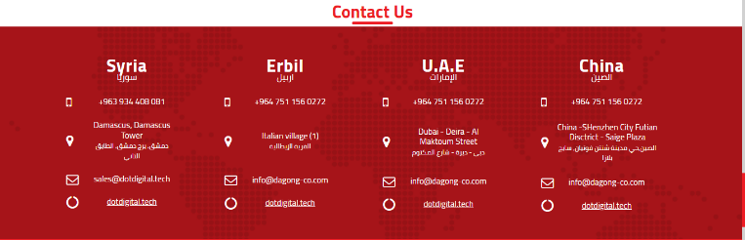
Site map
The following site map is proposed, the site map may change during the development of future plans.
Home page Products container Collection section Contact us

Slide 4

Home page
Image: logo
On click location.href=‘/’
User icon:
Displays box including Logged in as, username, logout button (when logged in)
Displays box including Log in to start the shipping, login button
Search bar
List:
Categories
on click location.href=‘search/keyword’
Search button:
on click location.href=‘/search/searchKey’
(only if search bar is not empty)

Slide 5

Products container
Arrow(full height)
On click
moves the slider to the left
Arrow(full height)
On click
moves the slider to the right
Product card:
On click (anywhere)-> location.href=‘/products/product_id’

Slide 6
collections
Collection title:
On click -> location.href=
‘/search/collectionTtile’

Slide 7
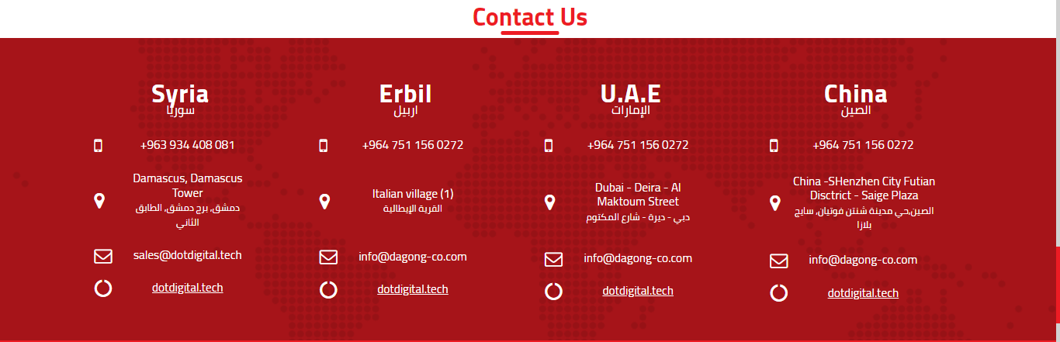
Contact us

Slide 8
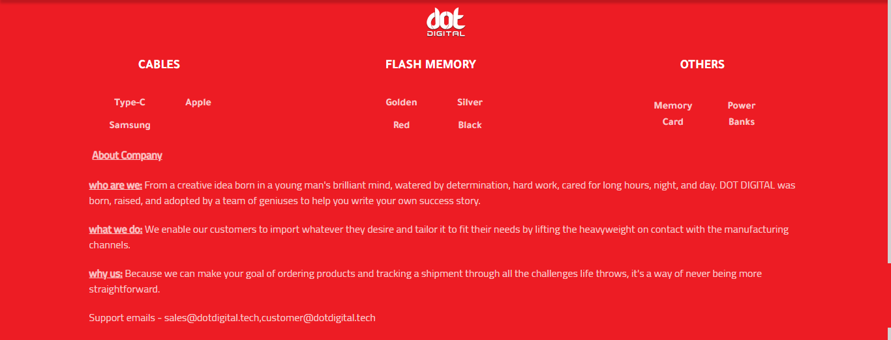
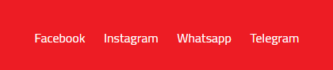
footer
Social links:
Facebook page, Instagram page, WhatsApp sales chat, Telegram channel
List-items:
On click -> location.href= ‘/search/keyword’

Slide 9
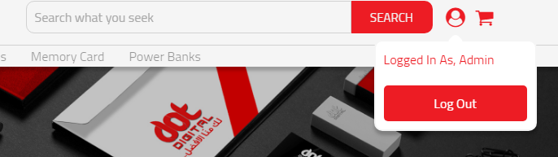
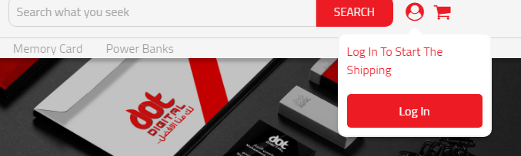
General topics & functionality
User icon clicked:
When logged out
When logged in

Slide 10
General topics & functionality
Searching a product: the search is done by typing a product name in the search bar, click on search button.
basic nlp is used: (search-nlp.js) ex.: mobile -> mob flash -> flh cable -> abl card -> ard memory -> mem charger -> hrg power -> owr bank -> ank
*nlp: neural language processing

Slide 11
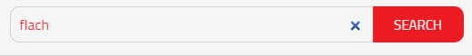
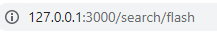
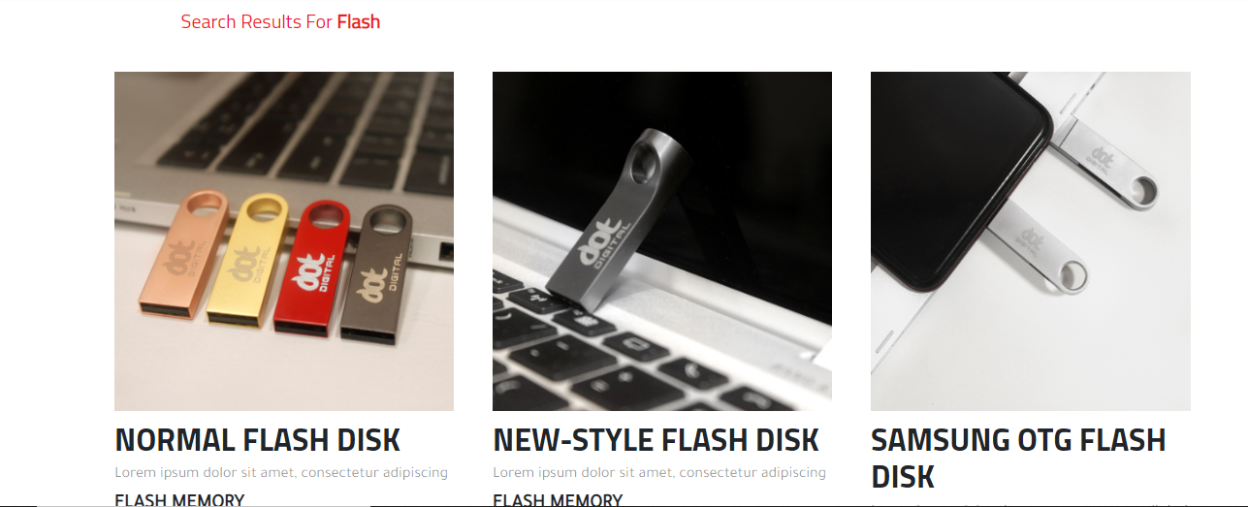
Searching for a product - 2

Slide 12
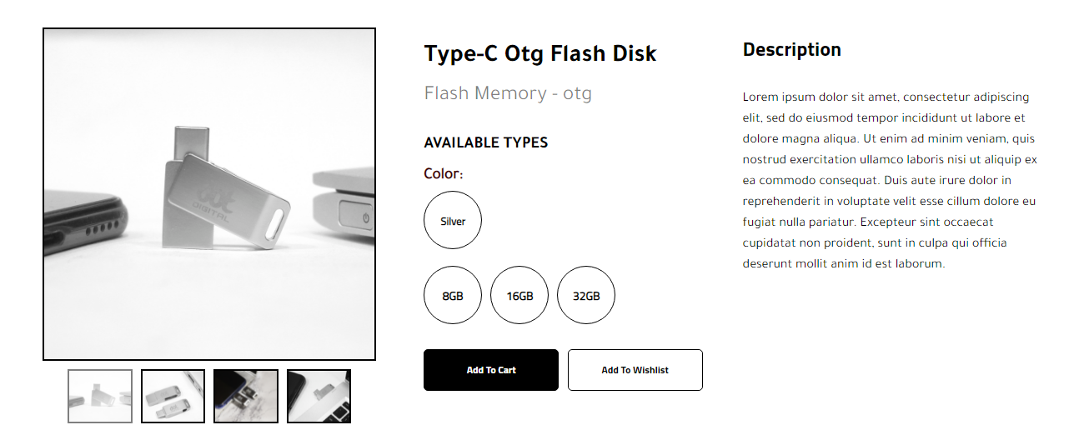
General topics & functionality
Product card clicked:
Colors available(sub category)
Sizes available(sub category)
Main image container:
Does zooming effect on hover
Image slider:
Contains four images of each product, changes main image container on click.
Add to cart/wish list button:
Made for future plans (does nothing in current phase)

Slide 13
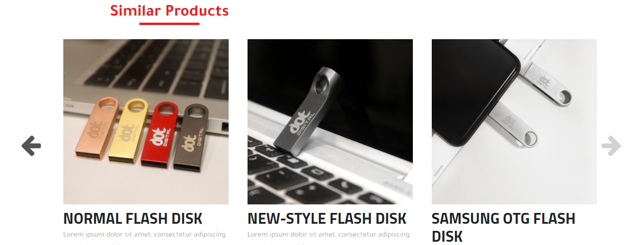
Products card clicked - 2
Second part of the section shows a slider contains similar products with shared tags.

Slide 14
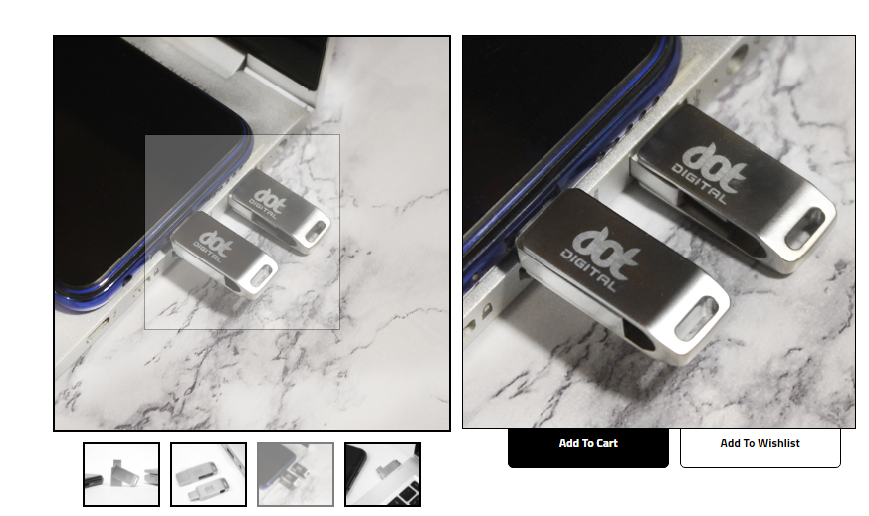
General topics & functionality
Hovering a product image: (zoomls.js-zoomls.css)
Displays & follows the cursor

Slide 15
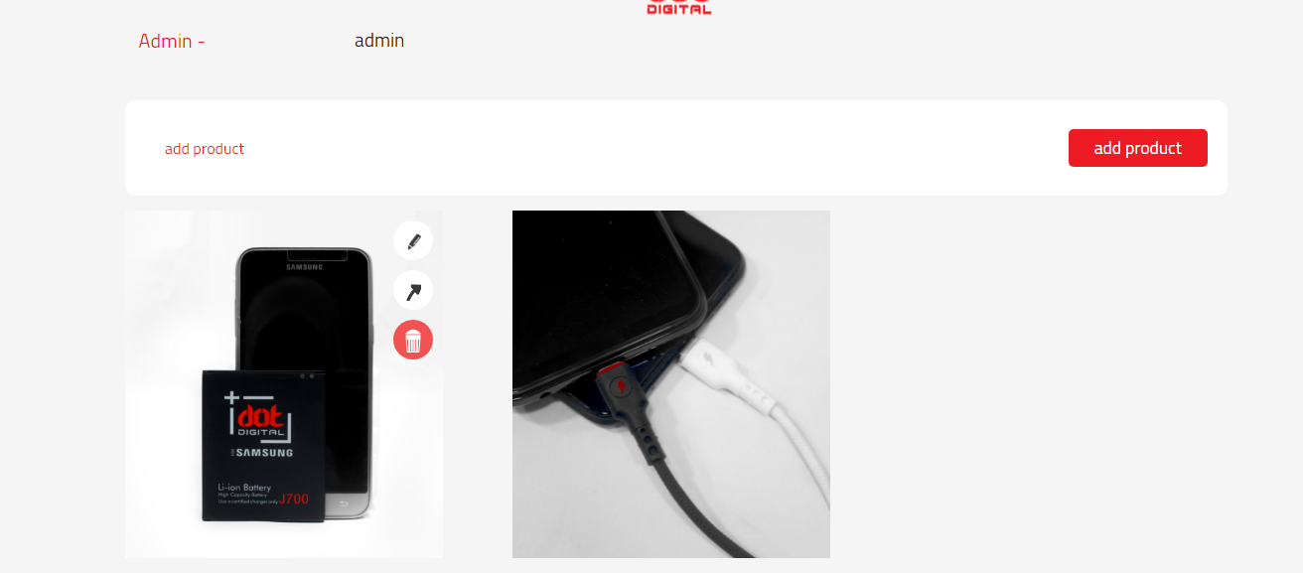
General topics & functionality
Admin page:
/admin
Accessible only when the user’s seller column is set to true in database
Accessible only when logged in or else goes to /login
Admin’s username stored in DB
Add product button:
Href=/add-product
Products were added by that admin
Buttons:
Edit
Show
Delete

Slide 16
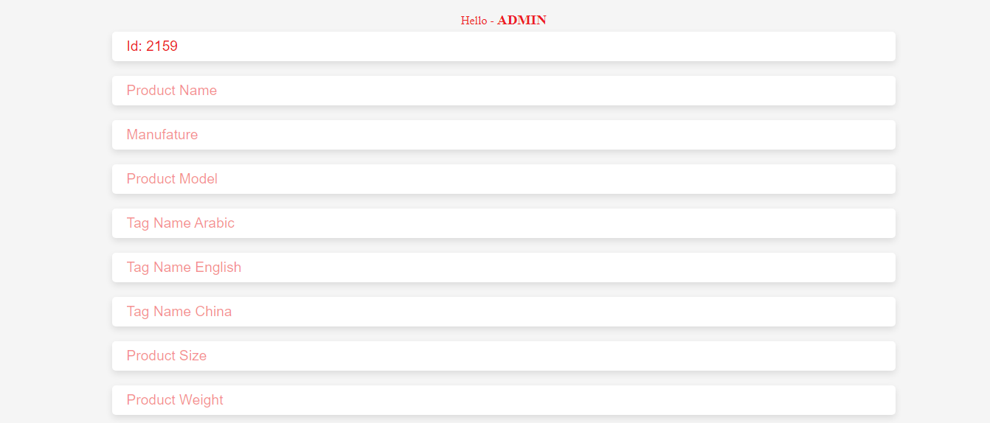
General topics & functionality
Add new product: /add-product
Accessible only when user’s admin.
Admin’s username stored in DB
Random generated ID
*Same as product name (read-only)

Slide 17
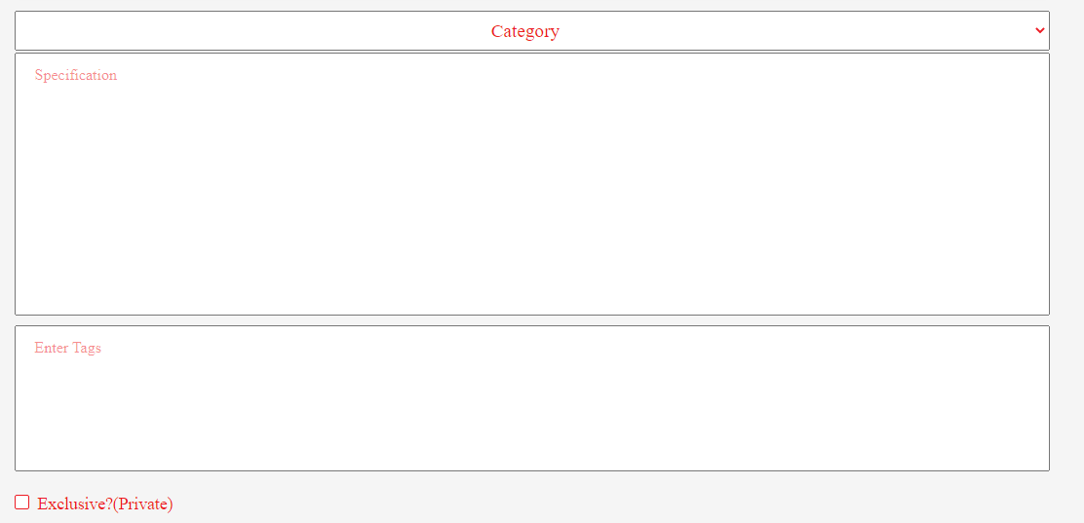
General topics & functionality
Add-product - 2
Categories available.
Tags used in each product:
Using split() function after each ‘,’
Ex: flash memory, storage, otg -> flash memory
storage
otg
future plans, private column for each product (boolean- true/false)

Slide 18
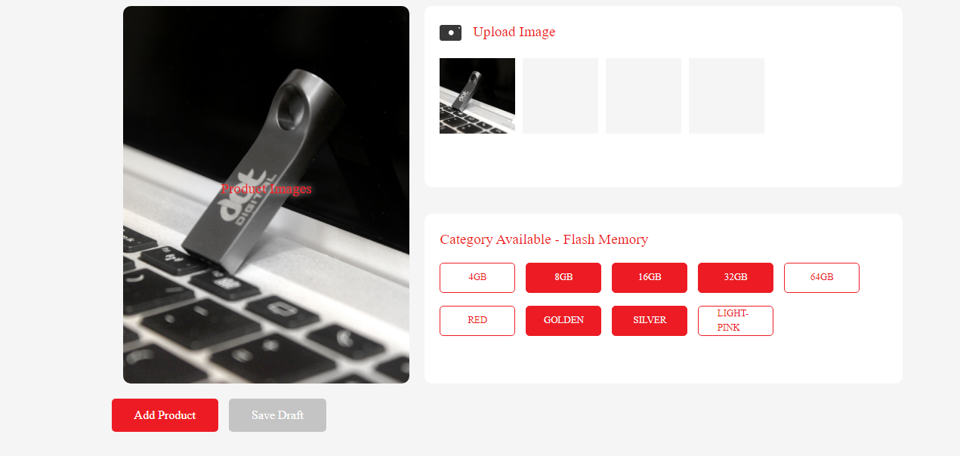
General topics & functionality
Upload images container:
Max allowed four images,
Can be one image
Add-product -3
Image show
Available sub categories
Add product button:
Insert new product info to DB, after applying validation form (server-side)
Save draft button:
Stores new product information to DB but does not display until it’s draft column in the DB goes to false.

Slide 19
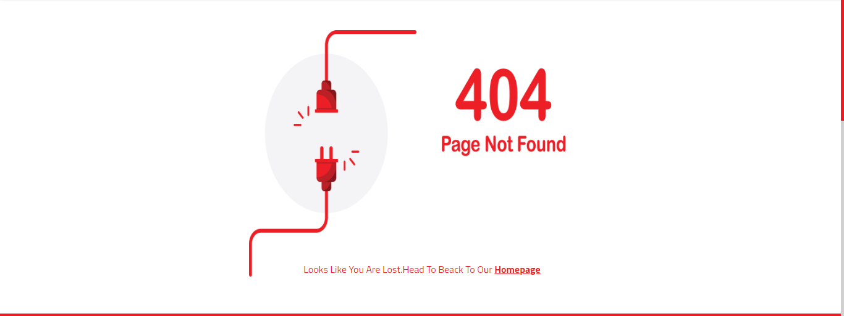
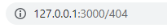
General topics & functionality
Typing an unknown destination (url):
Anchor to return /root

